Slide 1
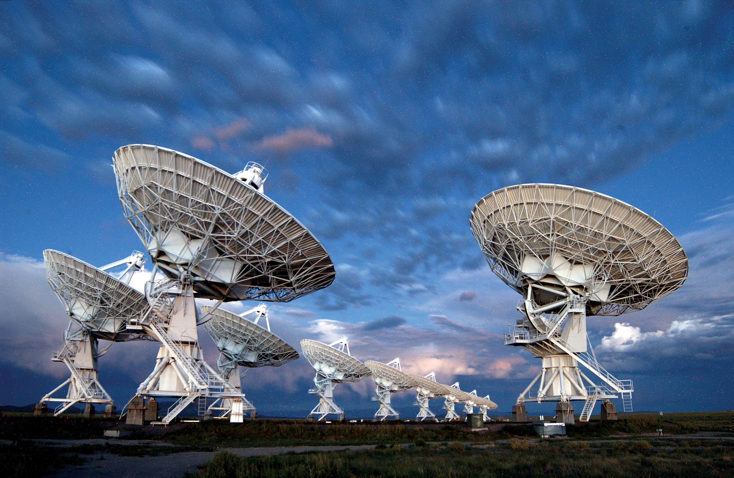
Astronomical radio source detectors
24th July 2023
Computer Science Department
Patrick ARLT
Supervisors:
Prof. Svyatoslav Voloshynovskyy Dr. Olga Taran

Slide 2
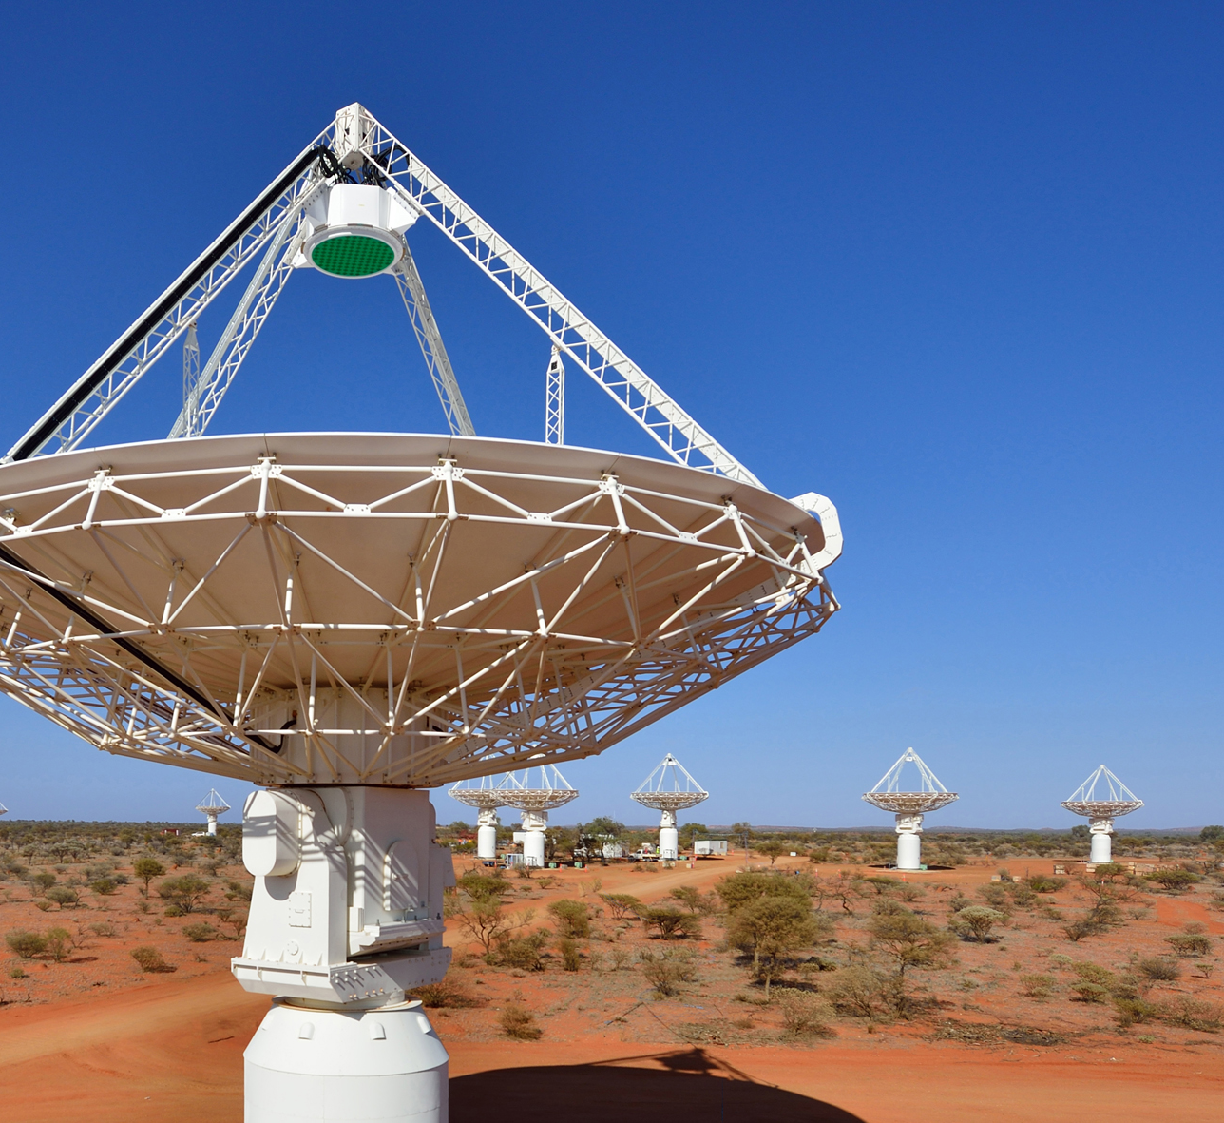
Content
Introduction
Thesis objectives
Context & Source detection problem
Datasets & Metrics
Morphological detector
PyBDSF
Karabo
Original PyBDSF
Machine learning approach
Conclusion
Summary
Future work

Slide 3
Introduction
Flora@contoso.com
http://www.contoso.com/

Slide 4
Thesis Objectives
Investigate the state-of-the-art PyBDSF source detector
Exploration of source detector based on morphological processing
Comparison of PyBDSF and morphological approaches and deep neural network algorithm

Slide 5
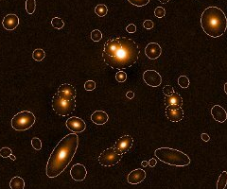



Context & Source Detection approaches
Traditional approaches
Morphological detector
PyBDSF
Karabo
Original PyBDSF
Machine learning based approach
Convolutional auto encoder
Notes:
Morphological : traditional computer vision (few domain expert knowledge)
Add image and explain that we are looking for the coordinate only

Slide 6
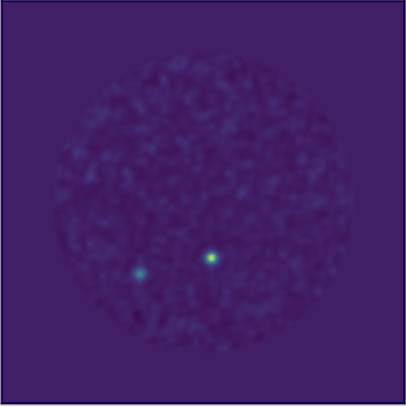
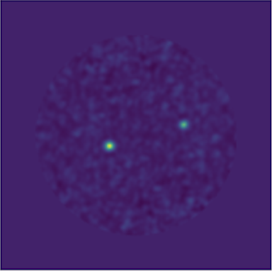
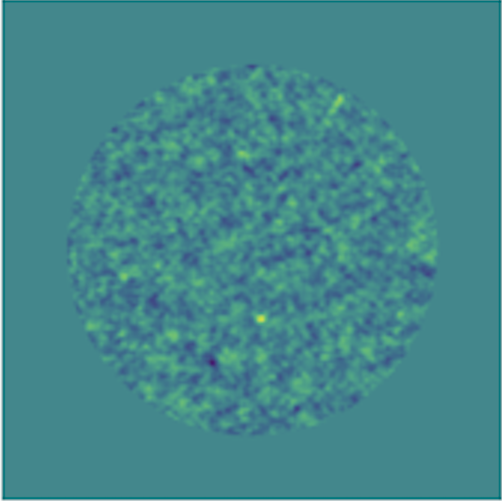
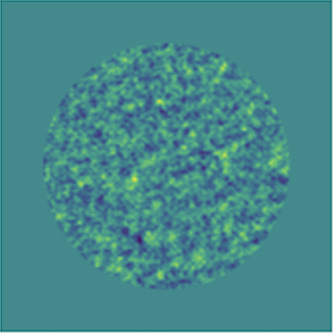
Dataset
Number of sources: 0 – 5
Source position: random
Source Type: Gaussian
Sky models size: 512x512
Pwv: 1’796
2 subsets:
Noiseless
Noisy
Training set: 7’331
Validation Set: 917
Testing Set: 916
O. Taran, O. Bait, M. Dessauges-Zavadsky, T. Holotyak, D. Schaerer, and S. Voloshynovskiy, "Challenging interferometric imaging: Machine learning-based source localization from uv-plane observations," Astronomy & Astrophysics (A&A), vol. 674, 2023.
Notes:
Noiseless perfect case – need to validate the bbaseline of the models
But in reality there is noise (humidity)

Slide 7
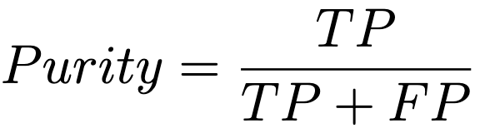
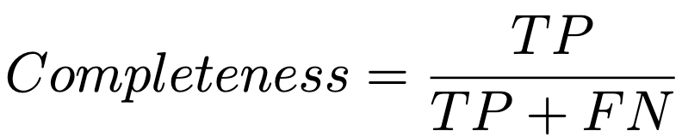
Metrics
TP: True Positives
FP: False Positives
FN: False Negatives
Notes:
Purity : reliability and accuracy
Completness: effectiveness
Exxplain purity (1-purity = amount of wrong detected
Complet =

Slide 8
Experiments
Flora@contoso.com
http://www.contoso.com/

Slide 9
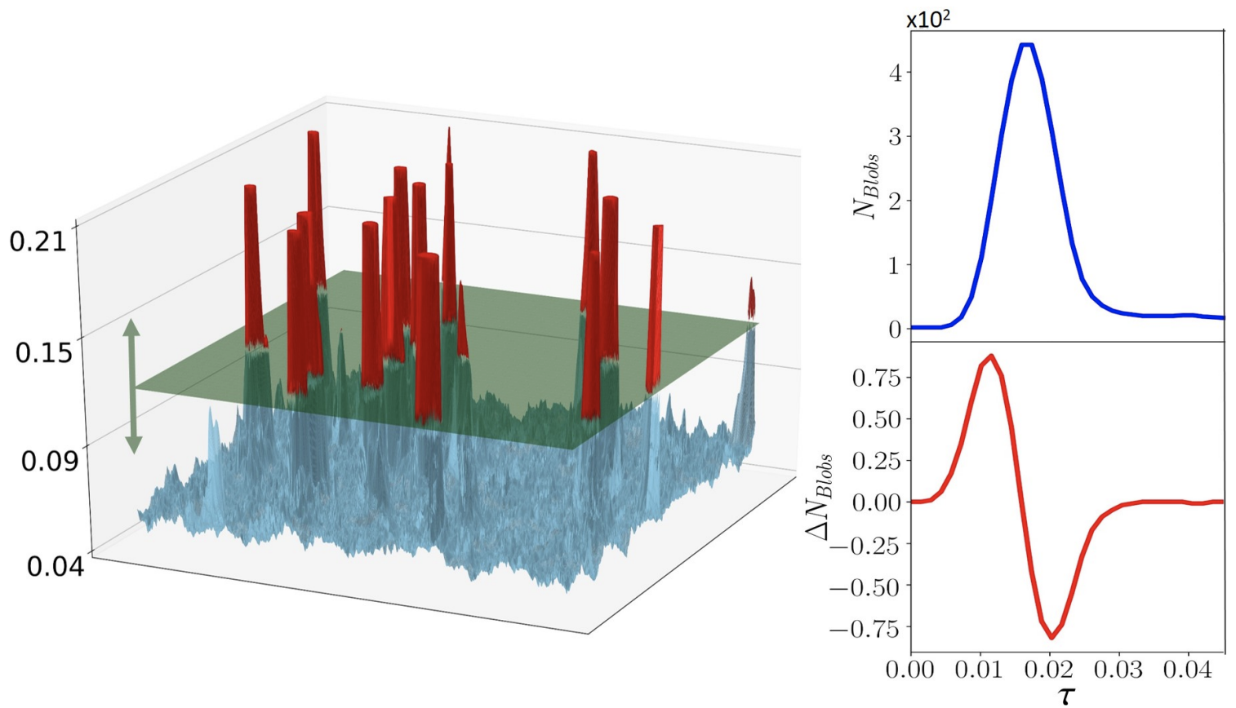
Morphological detector
Thresholded Blob Detection (TBD) technique
Flora@contoso.com
http://www.contoso.com/
A. V. Sadr, E. E. Vos, B. A. Bassett, Z. Hosenie, N. Oozeer, and M. Lochner, “Deepsource: Point source detection using deep learning,” MNRAS, vol. 484, no. 2, pp. 2793–2806, April 2019
9

Slide 10
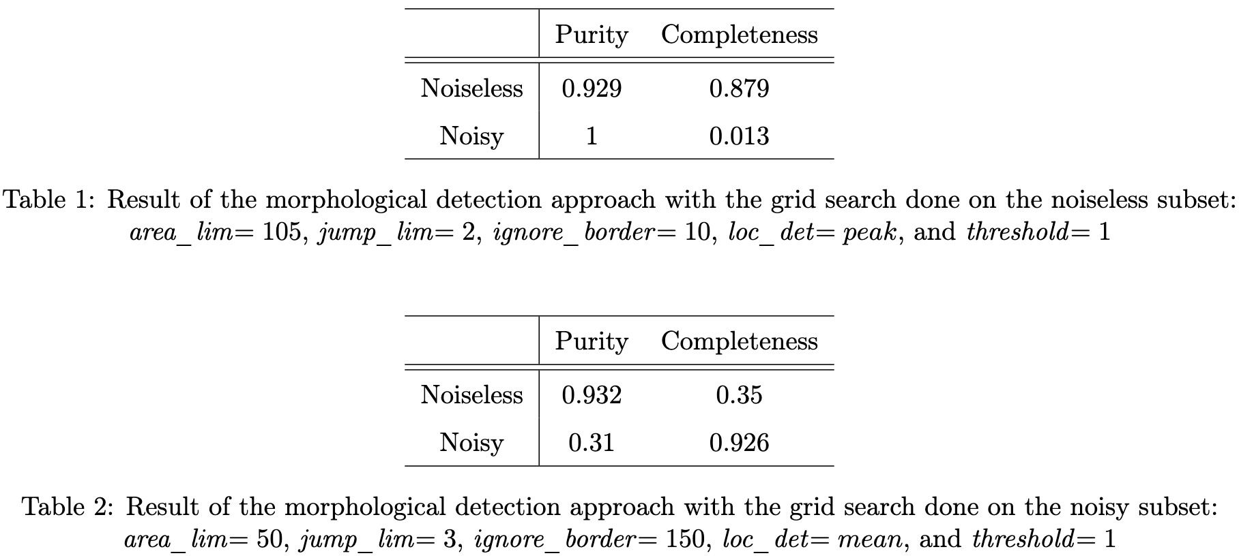
Results
Notes:
Explain the scores

Slide 11
Python Blob Detection and Source Finder
Extract sources from radio astronomical data
Make available their properties
PyBDSF
Karabo
Plenty of parameters
Demand expert domain knowledge
More complicated to use
Only few parameters
Intuitive
Easy-to-use
Flora@contoso.com
http://www.contoso.com/
N. Mohan and D. Rafferty, “Pybdsf: Python blob detection and source finder,” Astrophysics Source Code Library, pp. ascl–1502, 2015
https://github.com/i4Ds/Karabo-Pipeline/tree/main/karabo
11

Slide 12
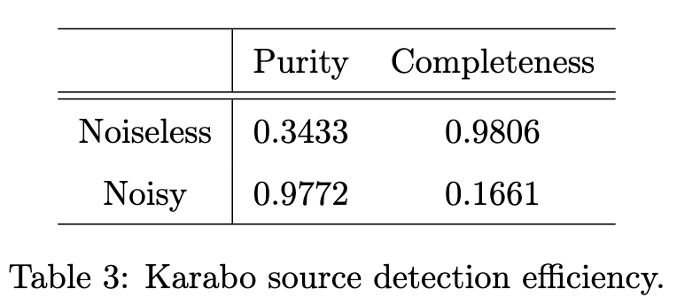
Results Karabo

Slide 13
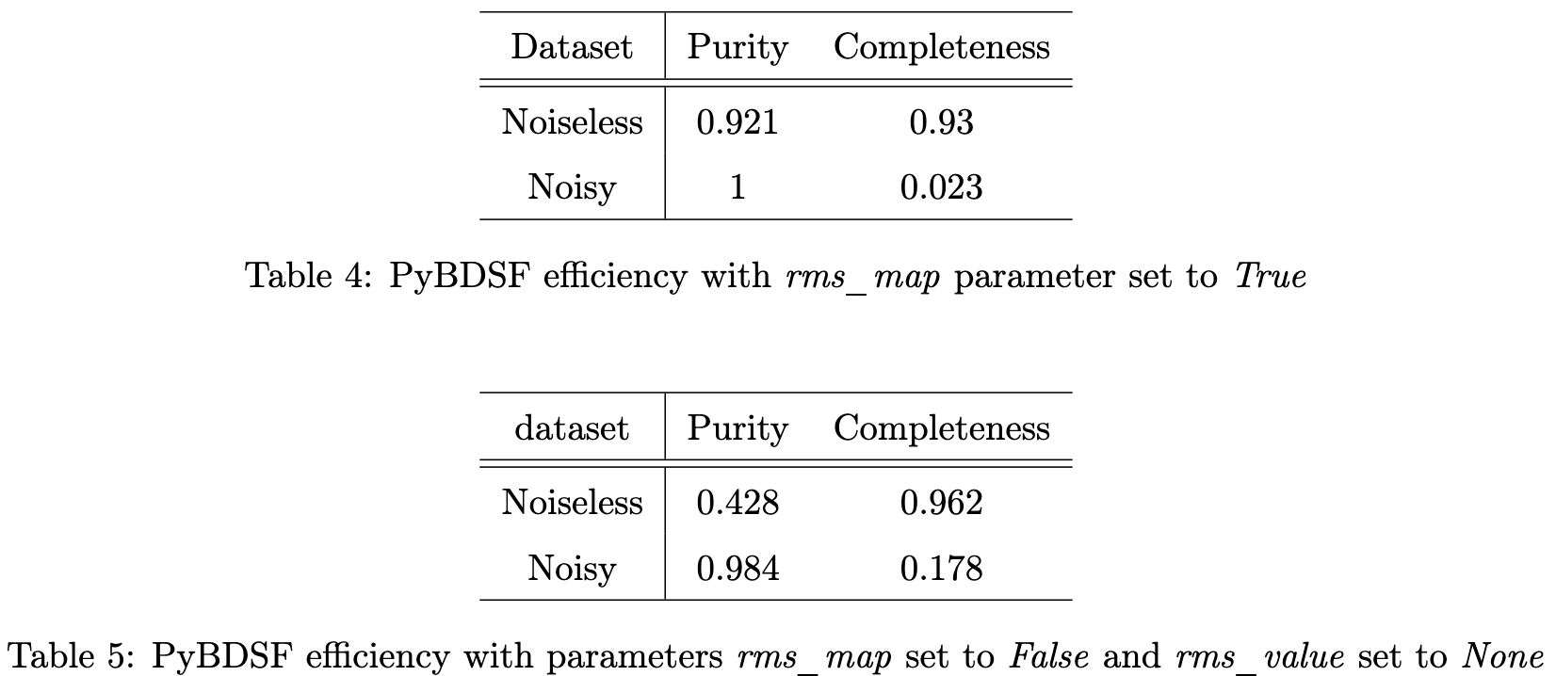
Results Pybdsf

Slide 14
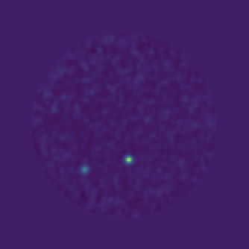
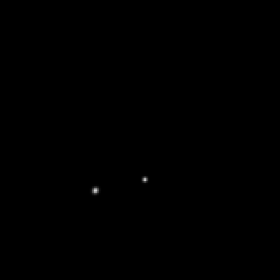
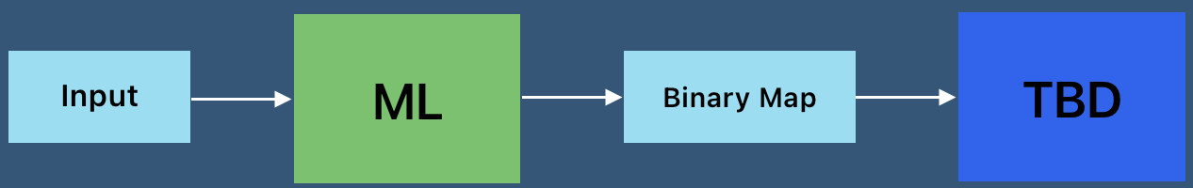
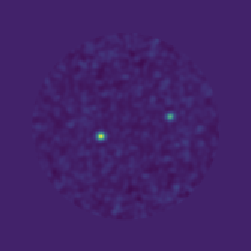
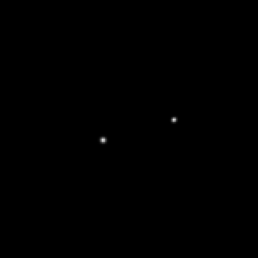
Machine learning approach
Flora@contoso.com
http://www.contoso.com/
14

Slide 15
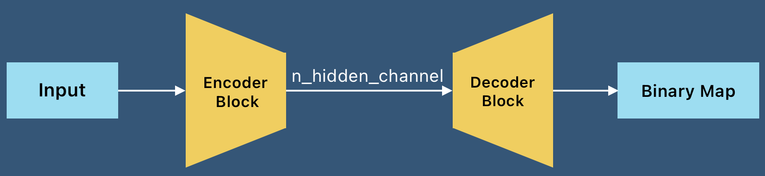
Auto encoder
Flora@contoso.com
http://www.contoso.com/
15
Notes:
Add a slide (input –> ML -> Bin -> TBD –> coord)
Then auto encoder

Slide 16
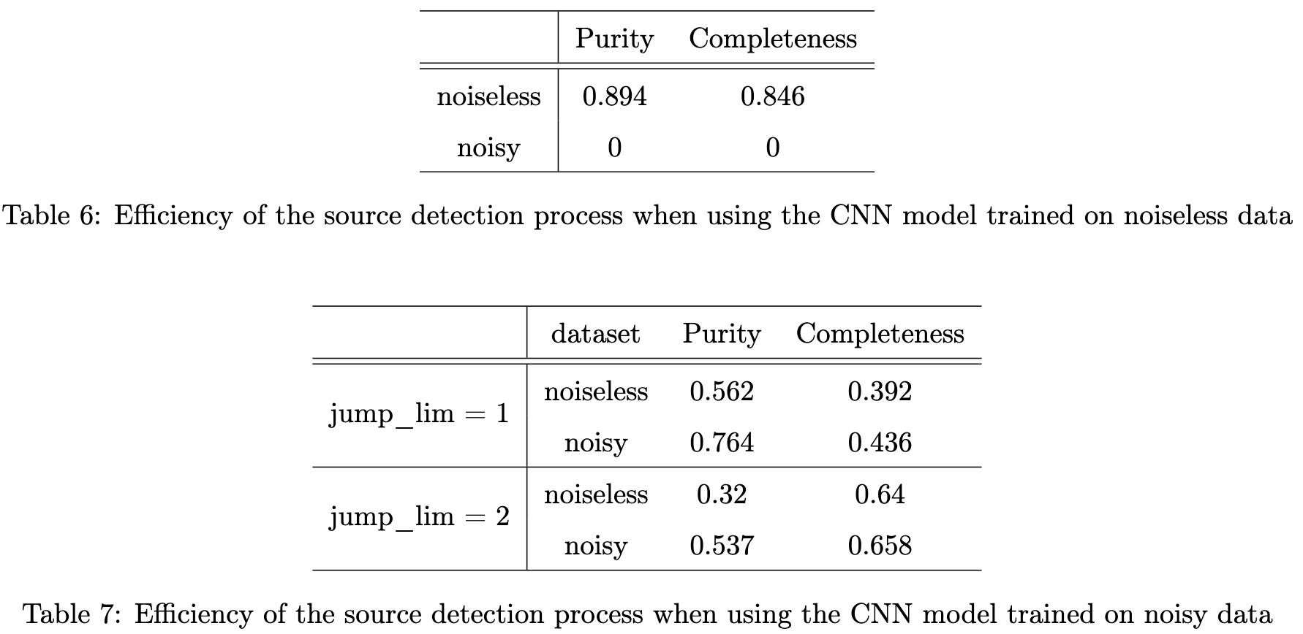
Results
Notes:
Too adapted to noise and struggles on noiseless

Slide 17
Conclusion
Flora@contoso.com
http://www.contoso.com/

Slide 18
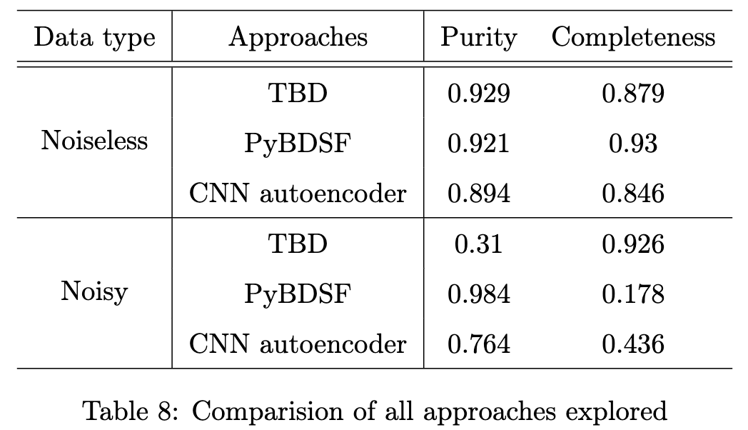
Summary
Notes:
Comparision 2 table noiseless and noisy with best results

Slide 19
Future Work
Train on both noiseless and noisy images
Extend the dataset (more complicated sources)
Explore more advanced architecture i.e. U-net, Transformers, DDPM, etc

Slide 20
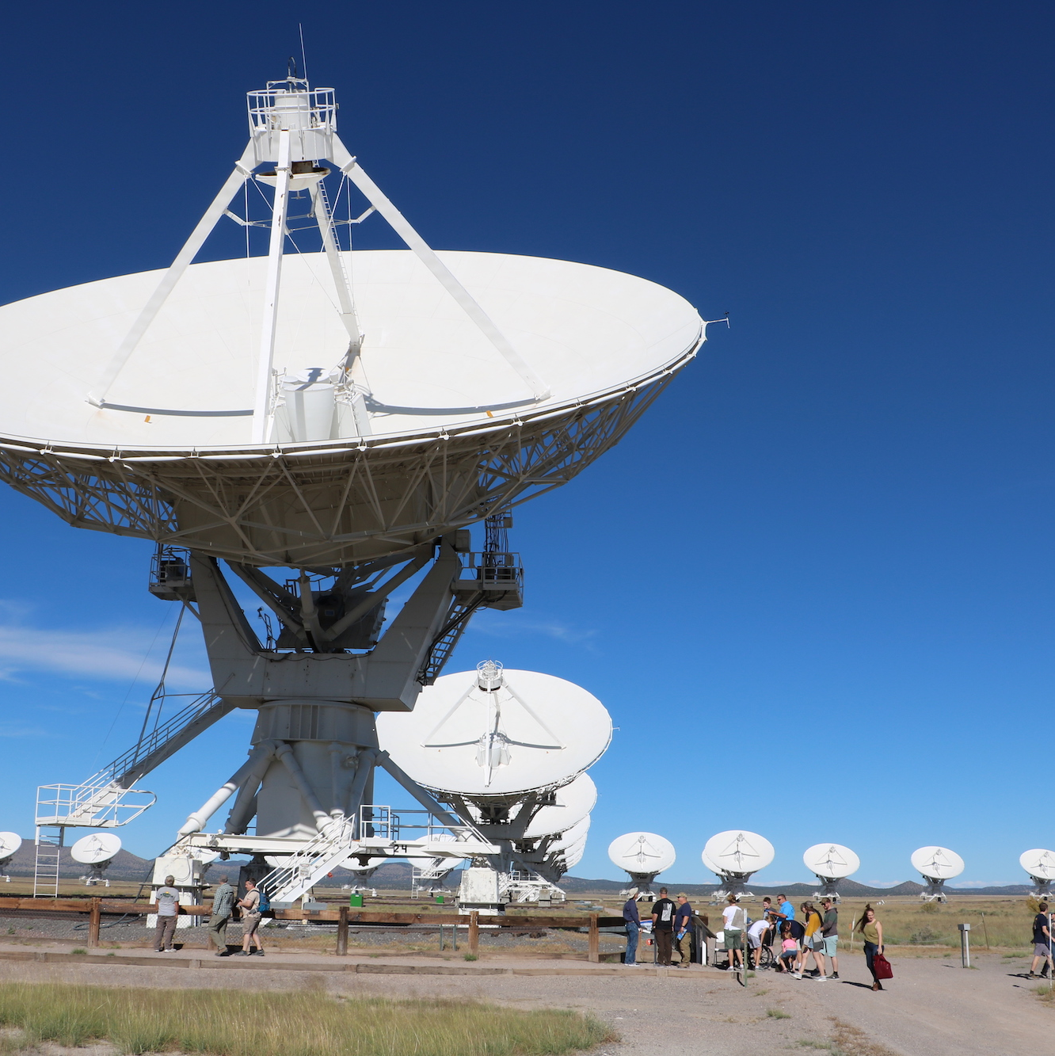
Thank you for your attention
Questions ?
Flora@contoso.com
http://www.contoso.com/

Slide 21
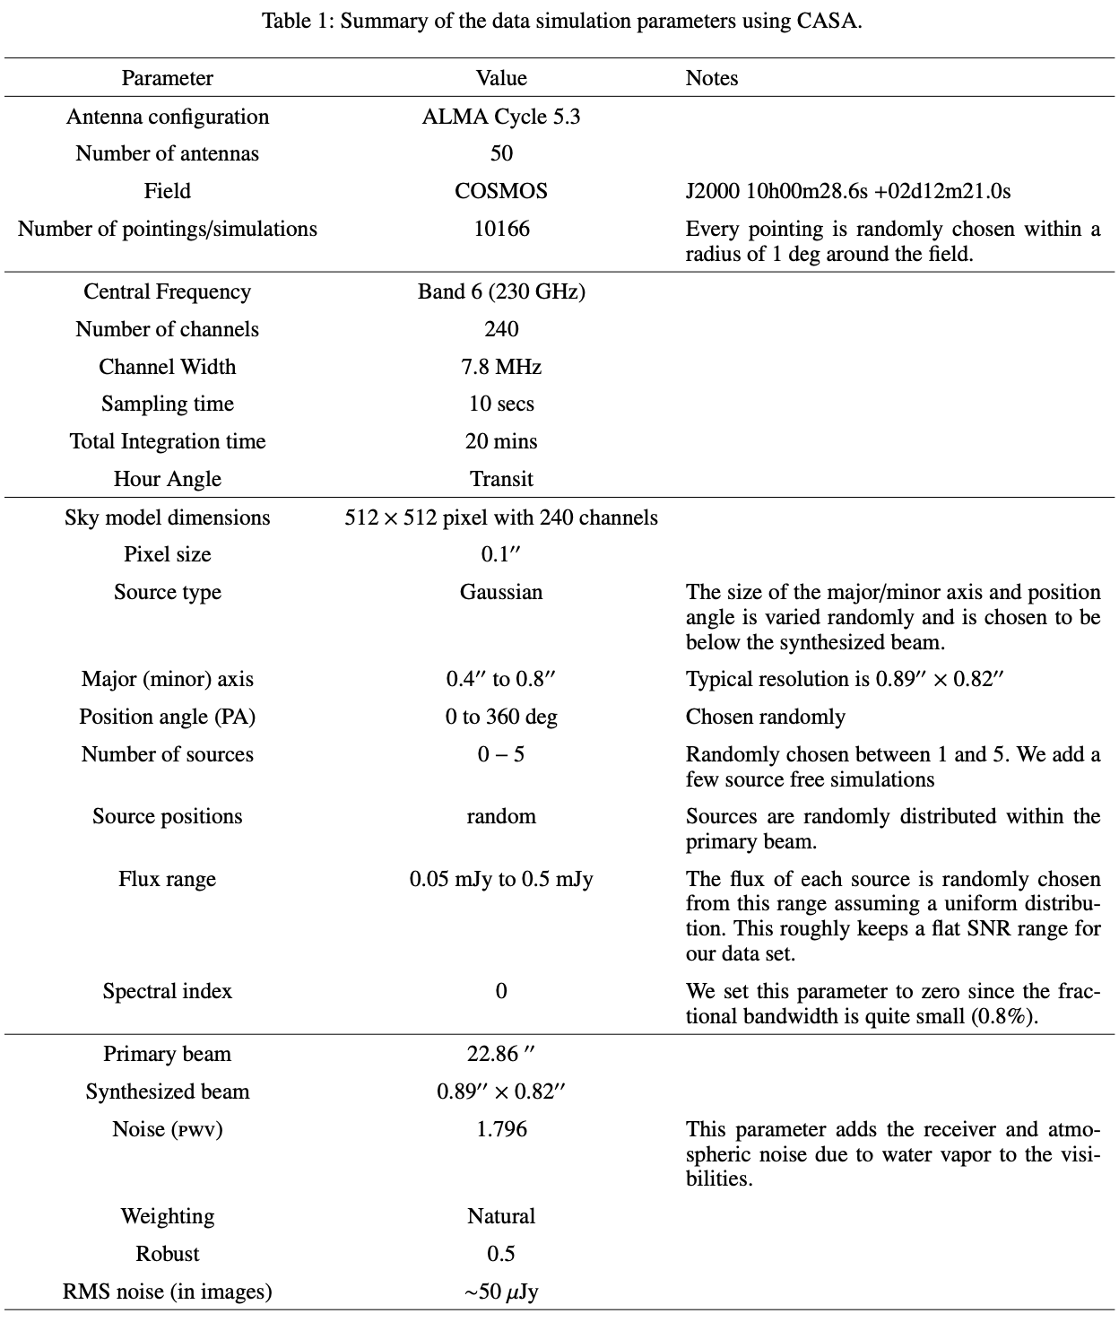
Dataset Details
Notes:
Too adapted to noise and struggles on noiseless

